Slide 1
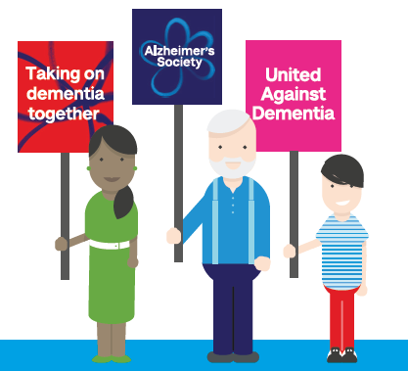
Let’s create a dementia-friendly generation
Alzheimer’s Society
Notes:
SUPPORTING INFORMATION:
- Ask students to put their hands up if they have heard of dementia, knows someone with dementia and if anyone would like to share what dementia is. - Explain that 1 in 3 young people know someone with dementia. This might be a grandparent, family member, neighbour. For some people, it may be their parent.
- Learning about dementia can help make things easier and give you some ideas about the things you can do together. If you don’t know someone with dementia, one of your friends might do, and learning a little bit more might help you to support your friends.

Slide 2
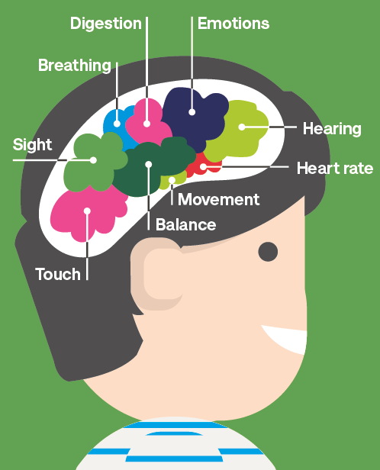
What is dementia?
Dementia is caused when the brain is damaged by diseases
There are over 100 different types of dementia, Alzheimer’s disease is the most common
It is progressive, which means it will get worse over time
Although dementia mainly affects older people, it is not a natural part of ageing
You can’t catch dementia, it’s not like the chicken pox or common cold
Just because someone in your family has dementia, doesn’t mean you will get it
Notes:
SUPPORTING INFORMATION:
Often people suspect they might have dementia because they start becoming forgetful or confused, for example: forgetting people’s names or how to get home
- The symptoms of dementia get worse over time. Every day tasks such as shopping or cooking become increasingly difficult and social situations become hard to manage, for example: recognising friends and family.

Slide 3
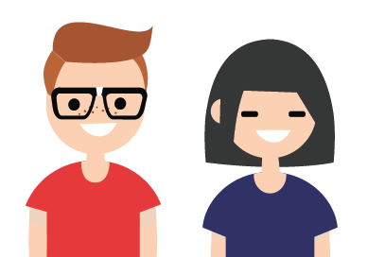
In the future, more people will be affected by dementia…
Currently there are 850 000 people living with dementia in the UK
That is equivalent to more than 22 Wembley stadiums at full capacity.
Notes:
SUPPORTING INFORMATION:
The number of people with dementia is steadily increasing
While dementia is more common in older people, it is important to remember that it is not a natural part of ageing – not all older people will develop dementia.
There are around 40,000 people under the age of 65 living with dementia

Slide 4
What are the symptoms of dementia?
Every person with dementia is different, so not everyone will have the same symptoms.
Symptoms may include:
Forgetting things
Finding it hard to get the right words out
Getting lost
Getting mixed up about dates and times
Reacting differently to normal
Alzheimer’s Society
Notes:
SUPPORTING INFORMATION:
- Forgetting things: particularly things that happened recently. Someone might remember things from a long time ago, but not remember what happened earlier in the day. You might also find that people repeat things a lot
- Finding it hard to get words out or understand: Sometimes people with dementia might struggle to find the right word for something or struggle to follow conversations.
- Getting lost: people might not recognise places they know really well and get confused on the way to the shops or a relative’s house
- Getting mixed up about dates and times: people with dementia might not know what day or year it is. They might get dressed in the middle of the night, or think they should be going to school or their job even though they haven’t been to school or work for a long time.
- Reacting strangely: someone might react differently to how you expect, like getting upset by things that they used to find funny.
These symptoms can cause people living with dementia to feel scared, lonely or upset.

Slide 5
Dementia doesn’t just affect the person living with the condition
Actress Carey Mulligan talks about how dementia affects her family:
As the video shows, dementia is a condition that has impacts on the whole family, friends and wider community.
Notes:
www.youtube.com/watch?v=HqDCdgJ-gTU

Slide 6
You can help people living with dementia
When people with dementia are supported by their families, friends and local community, they can continue to do the things they love to do for as long as possible.
Simple things will make a big difference:
Talk slowly and clearly
Be patient
If you see someone looking lost or confused, tell an adult you know and trust
Notes:
www.youtube.com/watch?v=HqDCdgJ-gTU

Slide 7
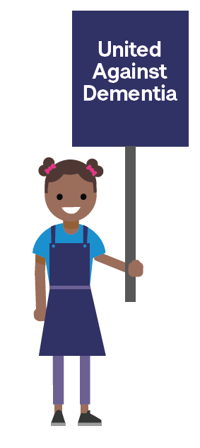
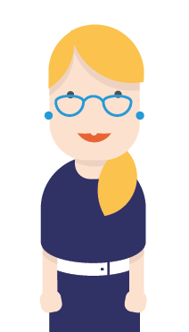
You can help people living with dementia
If someone can’t remember your name or something you do together, try not to get upset or frustrated.
There are still things you can do together, like listening to music or looking through old photographs.
Notes:
There are lots of things that you can do to support someone living with dementia.

Slide 8
Small changes can make a big difference
A day in the life of someone living with dementia:
What could you do to help someone living with dementia in your community?
Notes:
SUPPORTING INFORMATION:
- This video gives you an idea of day in the life of someone with dementia, and what can be done in the community to help them live well.
https://www.youtube.com/watch?v=Fz8ACEu7Lho
What could you do to help people living with dementia in your community?
For example: be patient, if you see someone struggling ask an adult you know to help, talk clearly and slowly, setup a memory café at school and invite people from the local community.

Slide 9
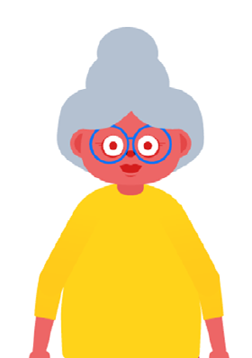
If you are worried, or have any questions about dementia…
Talk to a parent, guardian or adult that you know and trust
Visit alzheimers.org.uk for information
Call the National Dementia Helpline on 0300 222 1122
Notes:
SUPPORTING INFORMATION:
- This video gives you an idea of day in the life of someone with dementia, and what can be done in the community to help them live well.
https://www.youtube.com/watch?v=Fz8ACEu7Lho

Slide 10
What does Alzheimer’s Society do?
Alzheimer’s Society is the UK’s leading dementia charity:
Research
Information, training and support
Creating a dementia-friendly society
Notes:
SUPPORTING INFORMATION:
Alzheimer’s Society is the UK’s leading dementia charity. We provide information and support, improve care, fund research and create lasting change for people affected by dementia.
Every day, we work tirelessly to find new treatments and, ultimately, a cure for dementia.
We provide expert information, training and support services to all those who need our help.
And we are creating a more dementia-friendly society so people with the condition can live without fear and prejudice.

Slide 11
Unite with us against dementia!
Become a Dementia Friend!
Visit DementiaFriends.org.uk and watch a short video
Pledge an action to help someone living with dementia
Wear your Dementia Friends badge
Notes:
A Dementia Friend learns a little bit more about what it's like to live with dementia and then turns that understanding into action - anyone of any age can be a Dementia Friend.

Slide 12
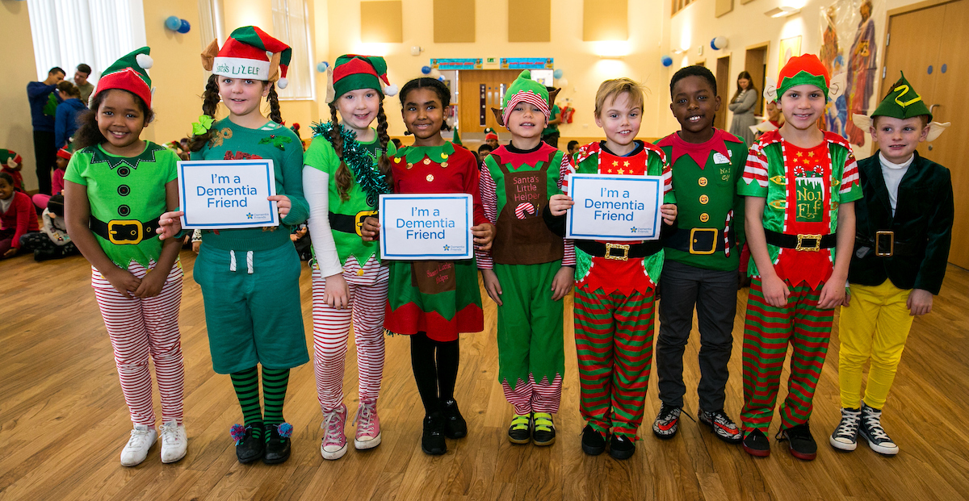
Unite with us against dementia!
Fundraise for us
Attend a Memory Walk and walk for a world without dementia
Unleash your inner elves and donate £1 to dress up like an elf on Elf Day!

Slide 13
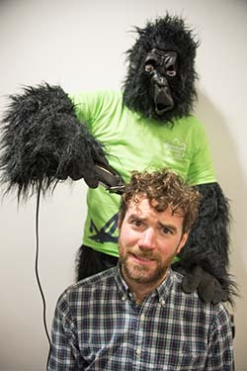
Unite with us against dementia!
Rise against dementia by taking part in Cupcake Day
Organise your own event and ask people to come along for a small donation
Fundraise for us
Help us support people with dementia today and find a cure for tomorrow.

Slide 14
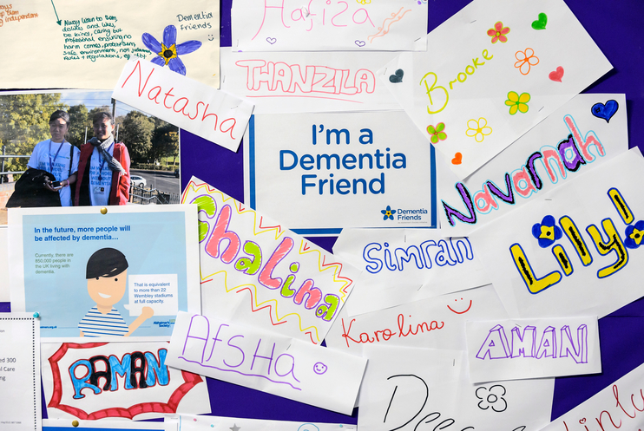
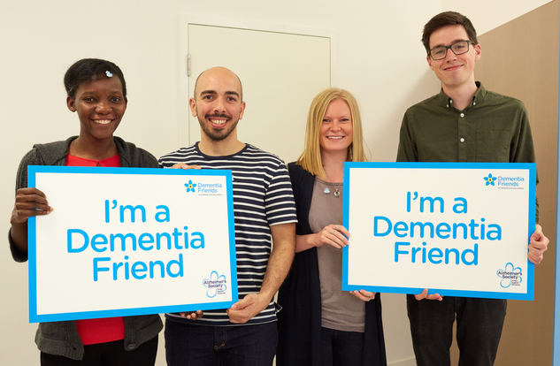
Unite with us against dementia!
Raise awareness
Raising awareness with other students or the local community
Inviting local people with dementia into the school for a memory café
Visit residents of a local care home and do an activity together
Notes:
During Dementia Awareness Week in May, show you are united against dementia by:

Slide 15
Let’s create a dementia-friendly generation
@AlzheimersSoc
youngpeople@
alzheimers.org.uk
Notes:
more might help you to support your friends.

